Slide 1
Project Title Sales Performance Analysis of Walmart Stores Using Advanced MySQL Techniques

Slide 2
Introduction: Walmart, a major retail chain, operates across several cities, offering a wide range of products. The dataset provided contains detailed transaction data, including customer demographics, product lines, sales figures, and payment methods.
Tools used:
MYSQL, Excel(for visuals)
Objective:
Analyze sales data using SQL

Slide 3
Dataset Overview:

Slide 4
Task 1: Identifying the Top Branch by Sales Growth Rate
Objective:
Walmart wants to identify which branch has exhibited the highest sales growth over time
SQL Query:
alter table walmartsales1 add column new_date date;
alter table walmartsales1 drop column date;
update walmartsales1 SET new_date = STR_TO_DATE(Date, '%d-%m-%Y’);
SELECT Branch, MONTH(new_date) AS Sale_Month,
sum(quantity) as total_sales,
round(SUM(Total),2) AS Monthly_Sales_revenue
FROM walmartsales1
GROUP BY Branch, month(new_date)
ORDER BY Branch, Sale_Month;
This query calculates monthly sales and revenue per branch

Slide 5
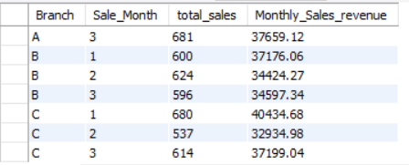
Output Table In the output table we only calculate monthly sales and revenue per branch to compare growth rate we use excel charts

Slide 6
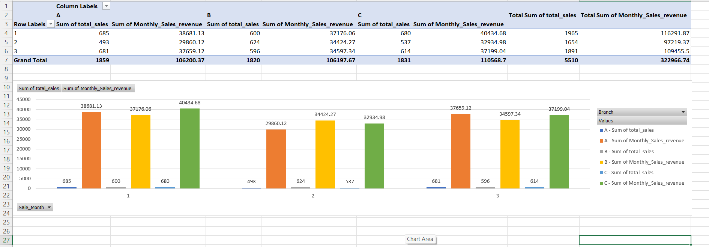
Visuals: So to compare growth rate across months here are three visuals to show it better first a bar chart followed by two line charts one showing total sales and one for total revenue

Slide 7
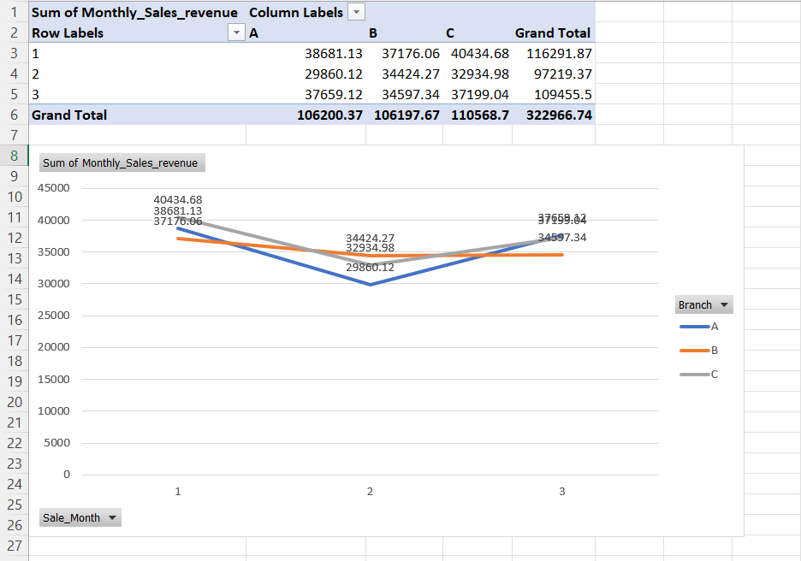
Revenue Comparison:

Slide 8
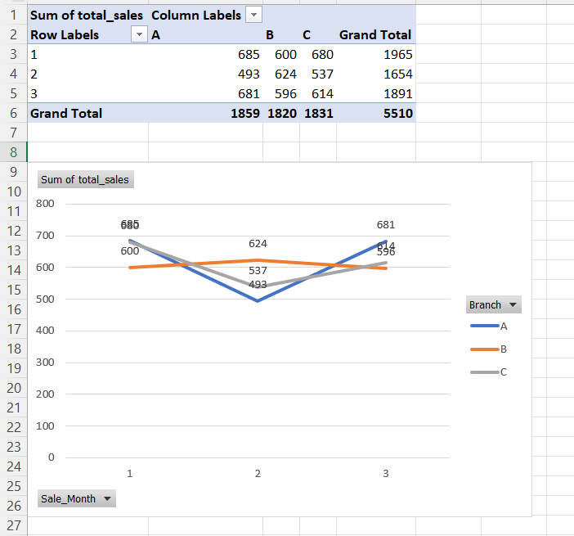
Sales Comparison:

Slide 9
Task 2: Finding the Most Profitable Product Line for Each Branch
Objective:
Walmart needs to determine which product line contributes the highest profit to each branch
SQL Query:
select Branch, `Product line`,
round(sum(`gross income`),2) as total_profit
from walmartsales1
group by branch, `product line`
order by branch,total_profit desc;
This query will give us all product line per branch with their revenue

Slide 10
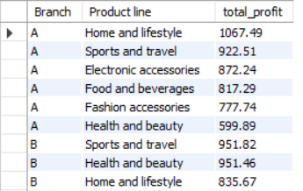
Output Table:

Slide 11
SQL Query to get only top product line per branch
with total_profit as (
select branch,`product line`,
round(sum(`gross income`),2) as revenue,
rank() over(partition by branch order by sum(`gross income`) desc) as rnk
from walmartsales1
group by branch,`product line`)
select * from total_profitwhere rnk =1;

Slide 12

Output Table:

Slide 13
Task 3: Analyzing Customer Segmentation Based on Spending
Objective:
Walmart wants to segment customers based on their average spending behavior as high, low, medium spenders
SQL Query:
select `customer id`,round(avg(total),2) as avg_total,
case
when avg(Total)<300 then "low“
when avg(Total) between 300 and 700 then "medium“
else "high“
end as spending
from walmartsales1
group by `customer id`;
This query will give us customers behaviour as high,low and medium spenders

Slide 14
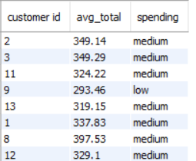
Output Table:

Slide 15
Task 4: Detecting Anomalies in Sales Transactions
Objective:
Walmart suspects that some transactions have unusually high or low sales compared to the average for the product line
SQL Query:
create temporary table avg_data as (
select `product line`, round(avg(total),2) as avg_sales
from walmartsales1
group by `product line`);
select * from avg_data;
with anomalies as (
select w.`product line`,w.`invoice id`,w.branch,w.gender,w.`customer id`, w.total,
Case when w.total > avg_data.avg_sales*1.7 then 'high anomaly’
when w.total < avg_data.avg_sales*.4 then 'low anomaly’
else 'normal’
end as anomaly
from walmartsales1 w
Join
avg_data on w.`product line` = avg_data.`product line`) select * from anomalies;

Slide 16
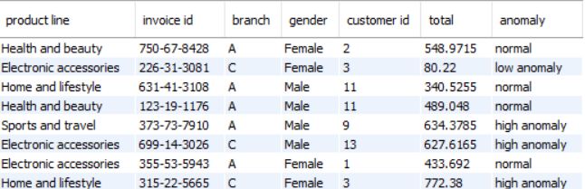
Output Table:

Slide 17
Task 5: Most Popular Payment Method by City
Objective:
Walmart needs to determine the most popular payment method in each city to tailor marketing strategies
SQL Query:
select city,payment,count(payment) as payment_method
from walmartsales1
group by city,payment
order by city,payment_method desc;
This query will give us all type of payment method across city

Slide 18
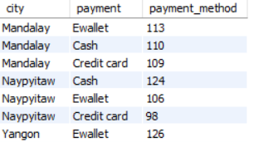
Output Table:

Slide 19
SQL Query to see only top payment method across city:
with payment_method as (
select city,payment,count(*) as payment_type,
rank() over( partition by city order by count(*) desc) as rnk
from walmartsales1
group by city,payment)
select * from payment_method
where rnk=1;

Slide 20
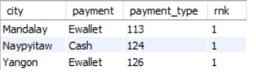
Output Table:

Slide 21
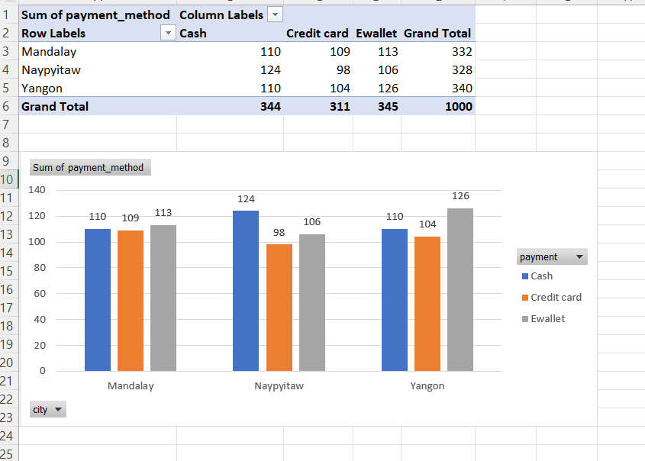
Visual representation:

Slide 22
Task 6: Monthly Sales Distribution by Gender
Objective:
Walmart wants to understand the sales distribution between male and female customers on a monthly basis
SQL Query:
select gender,month(new_date) as months,
sum(quantity) as total_sales,
round(sum(total),2) as total_revenue
from walmartsales1
group by gender,months
order by months,gender;
This query will give us sales and revenue distribution between genders across various months

Slide 23
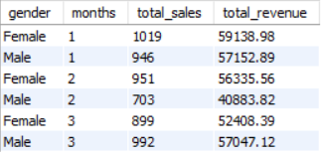
Output Table:

Slide 24
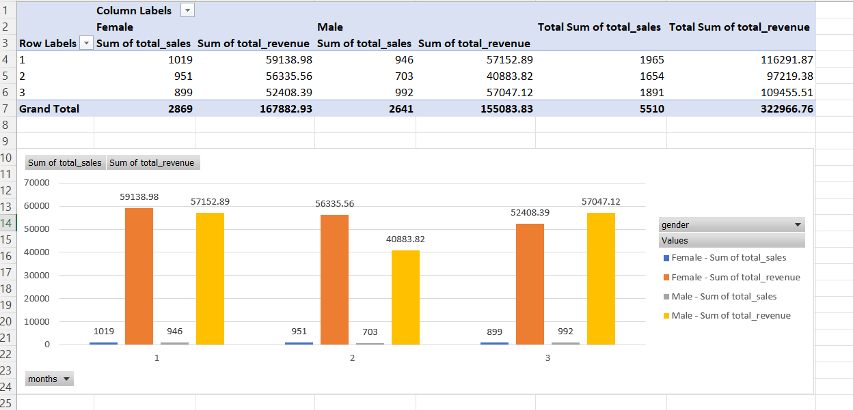
Visual Representation:

Slide 25
Task 7: Best Product Line by Customer Type
Objective:
Walmart wants to know which product lines are preferred by different customer types
SQL Query:
select customertype,`product line`,
count(`product line`)
from walmartsales1
group by customertype,`product line`;
This query will give us different product line across customertype

Slide 26
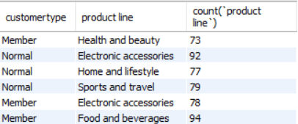
Output Table:

Slide 27
SQL Query to get only top product line for customertype:
with customer as (
select customertype,`product line`,
count(*) as product_count,
row_number() over(partition by customertype order by count(*) desc) as rnk
from walmartsales1
group by customertype,`product line`)
select * from customer
where rnk=1;

Slide 28

Output Table:

Slide 29
Task 8: Identifying Repeat Customers
Objective:
Walmart needs to identify customers who made repeat purchases within a specific time frame e.g., within 30 days
SQL Query:
with repeat_cust as (
select w.`customer id` as purchase_1,
b.`customer id` as purchase_2,
w.new_date as purchase_date_1,
b.new_date as purchase_date_2,
datediff(b.new_date,w.new_date) as days_difference
from walmartsales1 w
Join
walmartsales1 b
on w.`customer id`=b.`customer id`
where b.new_date > w.new_date)
select * from repeat_cust where days_difference <=30;
This query will give us customers who make a repeat purchase within 30 days of first purchase

Slide 30
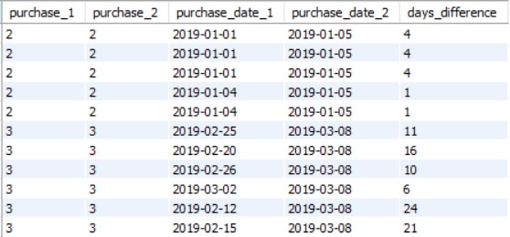
Output Table:

Slide 31
Task 9: Finding Top 5 Customers by Sales Volume
Objective:
Walmart wants to reward its top 5 customers who have generated the most sales Revenue
SQL Query:
select `customer id`,
round(sum(total),2) as sales_revenue
from walmartsales1
group by`customer id`
order by sales_revenue desc limit 5;
This query will give us top 5 customers based on their purchases

Slide 32
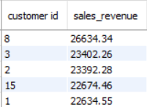
Output Table:

Slide 33
Task 10: Analyzing Sales Trends by Day of the Week
Objective:
Walmart wants to analyze the sales patterns to determine which day of the week brings the highest sales
SQL Query:
SELECT DAYNAME(new_date) AS Day_Of_Week,
COUNT(*) AS No_Of_Transactions,
sum(quantity) as total_sales,
ROUND(AVG(Total), 2) AS Avg_Sale_Per_Transaction,
round(SUM(Total),2) AS Total_Sales_revenue
FROM walmartsales1
GROUP BY Day_Of_Week
ORDER BY Total_Sales DESC;
This query will give us all data related to a single day whether it is total transactions, total sales, total revenue

Slide 34
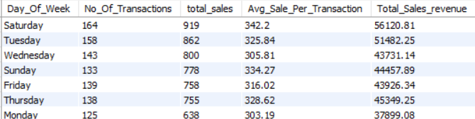
Output Table:

Slide 35
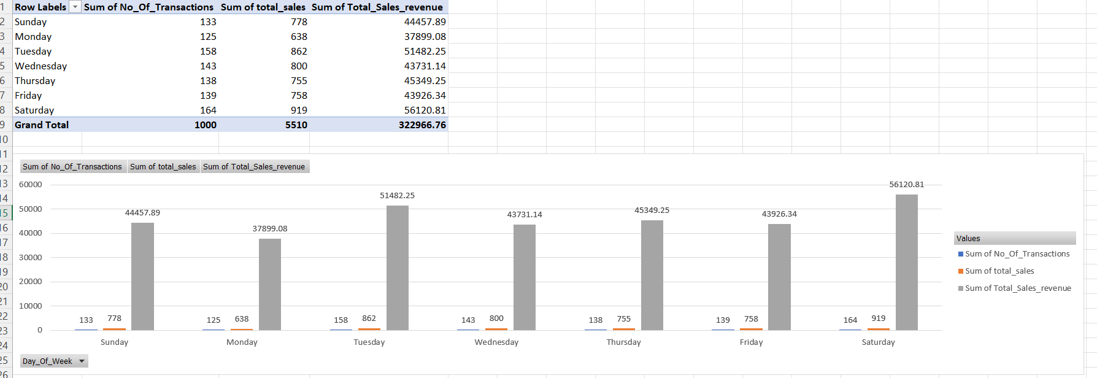
Visual Representation:

Slide 36
Challenges Faced:
Loading CSV file to MYSQL Workbench
Handling date and int columns

Slide 37
Learnings AND Conclusion:
Window functions
Joins, Temporary Table, many more SQL keywords
Data Preparation
Business insights:
From our findings we can say that Females generating more revenue comparing to Men’s,
Also weekends have generally more sales producing more revenue

Slide 38
Thank You
Project By GAJRAJ THUKRAN

